Slide 1
METHOD TRACE ANALYSER Team : Brainstorm
Developed By:
Sakshi Mishra
Satyam Jay
Jaismene Verma

Slide 2
Method TRACE
Method Trace has functionality to analyze the log file and generate the appropriate result
Trace from entry of Java Method to its exit in JVM
Keep track of the stack trace if any
Filter the method in log file based on classname, method name, or both

Slide 3
Method Trace Analyser
Aimed to assist developers in assisting the code
Commonly used post-mortem diagnostic method to identify problem
Beneficial in case of hang/performance related issues
Capable of comparing different methods based on the their runtime in graphical form

Slide 4
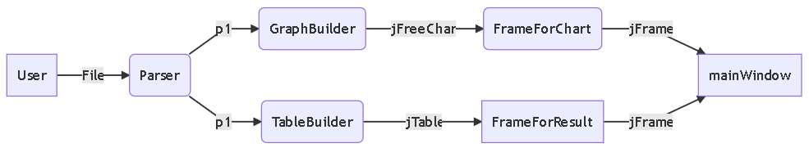
Trace Analyze Flow

Slide 5
Trace Analyze Flow
File1
p1
User
Parser
LogComparator
Critical Method
TableComparator
Jtable
MainWindow
File2
p2

Slide 6
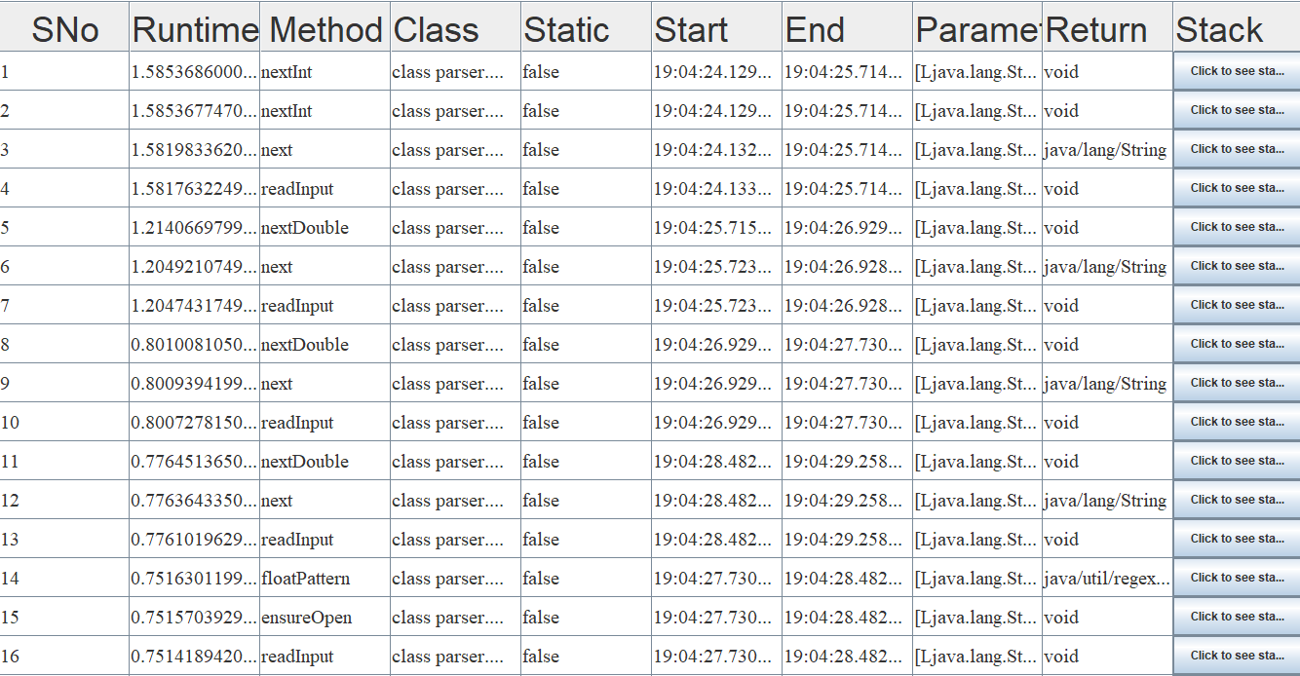
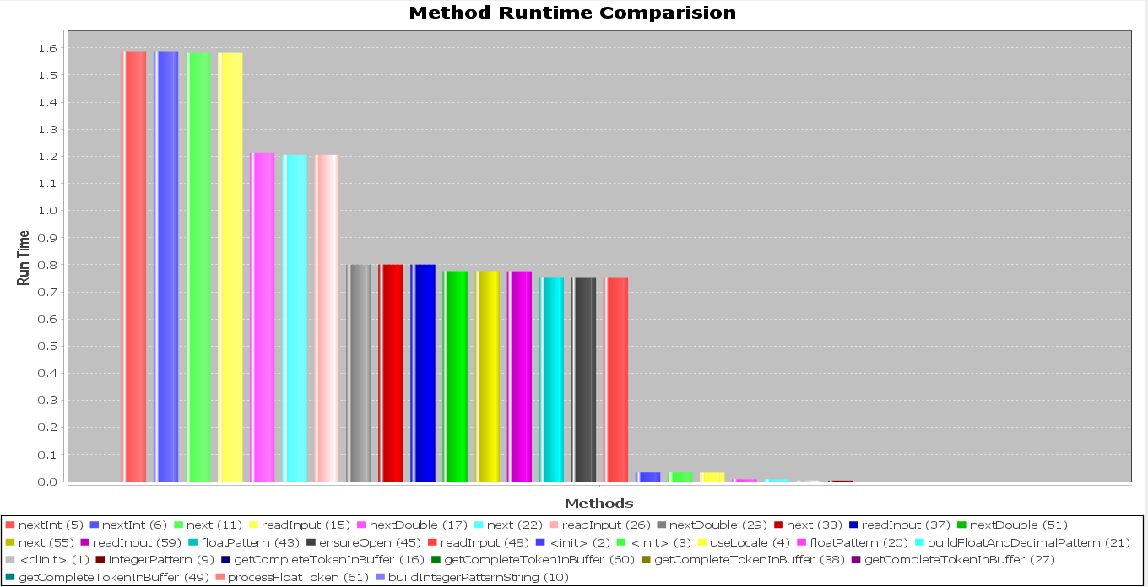
Screenshots

Slide 7
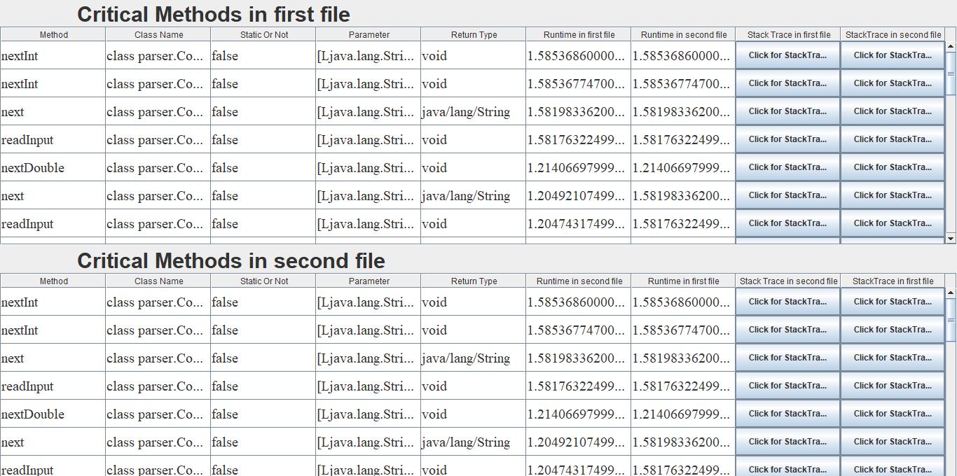
Log Comparison Screenshot

